Slide 1
Probability and Statistical Inference
Fundamentals

Slide 2
Types of Data Analysis
Qualitative Methods
Testing theories using language
Magazine articles/Interviews
Conversations
Documented observation
Newspapers
…..
Quantitative Methods
Testing theories using numbers (via statistics)

Slide 3
What is statistical inquiry?
The science of collecting, analysing, and drawing conclusions from data
The science of collecting, describing, and interpreting data.

Slide 4
What can statistics do?
Make data more manageable
6, 1, 8, 3, 5, 4, 9
We can calculate an average
We can state the range
We can plot them on a graph

Slide 5
What can statistics do?
What can Stats do?
Provide us with evidence from the data that allows us to draw conclusions from the data
Group of numbers #1: 6, 1, 8, 3, 5, 4, 9
Average is 5.14
Group of numbers #2: 8, 3, 4, 2, 7, 1, 4
Average is 4.25
Allows us to compare groups of data
Allows us to do this objectively and quantitatively

Slide 6
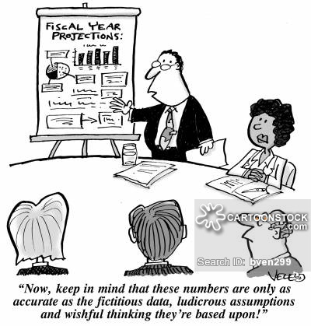

Slide 7
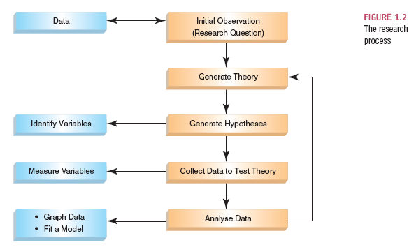
The Process (Source Andy Field)

Slide 8
Initial Observation
Find something that needs explaining
Observe the real world
Read other research
Test the concept: collect data
Collect data that will provide evidence you can test to see if your idea is valid
To do this you need to define variables
Anything that can be measured and can differ across entities or time.

Slide 9
The Research Process

Slide 10

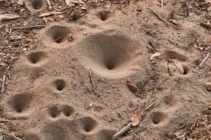
Conceptual Framework – Why is it important?
Bernd Heinrich
Spent a summer conducting detailed, systematic research on ant lions
Small insects that trap ants in pits they have dug.
When he conducted his analysis he found his results were very different to other researchers…
A good thing ? Was his research revolutionary?

Slide 11
Conceptual Framework
Repeated experiments following summer
Found that he and his team had misunderstood ant lion behaviour
In particular the time frame involved
Missed specific behaviour that impacted the results
“Even carefully collected results can be misleading if the underlying context of assumptions is wrong”
Bernd Heinrich, 1984

Slide 12
Conceptual Framework
System of
concepts,
assumptions,
expectations,
beliefs, and
theories that supports and informs your research
A key part of your design
A conception or model of what is out there that you plan to study, and of what is going on with these things and why
a tentative theory of the phenomena that you are investigating
Influences your design and in particular the data you need to collect/use

Slide 13
Generating and Testing Theories
Theory
A hypothesized general principle or set of principles that explains known findings about a topic and from which new hypotheses can be generated.
e.g. Computer Science attracts students with strong mathematical ability
Hypothesis
A prediction from a theory.
E.g. the number of people applying for an MSc in Computer Science will have basic mathematical ability greater than the general level in the population.
Falsification
The act of disproving a theory or hypothesis.

Slide 14
The Research Process

Slide 15
What data am I interested in/do I need?
Population
The entire set of individuals or objects of interest or the measurements obtained from all individuals or objects of interest
The world you are interested in and trying to build a model of.
Two kinds of populations:
finite or infinite.
Sample
A portion, or part, of the population of interest
Statistical inquiry is usually carried out with a SAMPLE

Slide 16
Population v Sample
Need to understand the nature of the population
Need the sample to be representative
Factors influencing the accuracy of a sample’s ability to represent a population:
Size
Randomness
If Sample is not representative it is biased.

Slide 17
Basic Terms
Individuals are the people or objects being studied
The set of data collected about each individual is referred to as a case
Variable
A characteristic about each individual of a population or sample.
Any characteristic whose value may change from one individual to another.
Structured to facilitate comparison between individuals.
Data
Value of a variable for individual observations.
Dataset:
The set of values collected for the variable(s) from each of the individuals belonging to the sample/population the dataset represents.
Each case in a dataset has one datum or observation for each variable.

Slide 18
Basic Terms
Experiment
A planned activity whose results yield a set of data.
Parameter
A numerical value describing an aspect of an entire population.
Statistic
A numerical value describing an aspect of the sample.

Slide 19
Parameter V Statistic
Both are descriptions of groups
Both allow us to make statements about a group like “50% of dog owners prefer X Brand dog food.”
For example
You randomly poll voters in an election.
You find that 55% of the population plans to vote for candidate A.
That is a statistic.
Why? You only asked a sample of the population who they are voting for.
You calculated what the population was likely to do based on the sample.
For small populations it is possible to measure to compute a parameter
For larger populations you will measure to compute a statistic

Slide 20
Example
A country is interested in learning about the average age of its academic staff working at third level.
The basic terms in this situation:
The population is all academic members working in the country and we want to determine their age.
A sample is any subset of that population.
For example, we might select 50 staff members and determine their age.
As long as this is representative and sufficiently large to model the population.
The variable is the “age” of each staff member.
One datum would be the age of a specific faculty member.
The experiment would be the method used to select the ages forming the sample and determining the actual age of each staff member in the sample.
The parameter of interest is the “average” age of all academic staff in the country.
The statistic is the “average” age for all academic staff in the sample.

Slide 21
Sample size
In an ideal situation, the entire population should be studied but this is almost impossible.
Majority of studies are performed on limited subjects drawn from the concerned population known as “sample population”.
The data obtained is analysed and conclusions are drawn which are extrapolated to the population under study.
Sample size - The number of cases n
E.g. n = 90
Too small a sample
May not lead to conclusions that are valid for the population
Too large a sample
Wasteful if a smaller sample would do
May have ethical implications dependent on the type of experiment/observation being undertaken
How do decide on sample size is something we will talk about

Slide 22
Sample
Biased Sampling Method:
A sampling method that produces data which systematically differs from the population from which it is taken.
Aim for a Simple Random Sample
A sample of n measurements from a population is a subset of the population selected in such a manner that every sample of size n from the population has an equal chance of being selected
Some things to note:
Researcher bias should not occur in the sample selection
May not always reflect the diversity of the population

Slide 23
Data Collection: What to Measure?
Hypothesis:
Consumption of Coca-Cola improves a student’s ability to concentrate.
Decide what variables you need
Independent Variable
The proposed cause
A predictor variable
A manipulated variable (in experiments)
Coca-Cola consumption in the hypothesis above
Dependent Variable
The proposed effect
An outcome variable
Measured not manipulated (in experiments)
A student’s ability to concentrate in the hypothesis above

Slide 24
Confounding Variables
Sometimes we are interested in establishing relationships/differences and then inferring cause and effect¹
This can be complicated by confounding variables
Variables which may or may not directly measured which has influence on other variables in the study
Two variables are confounding when one cannot be distinguished from the effects of another
E.g. amount of petrol and time used to commute to work, it is likely that level of congestion will be a factor
¹: We won’t actually be able to 100% demonstrate cause and effect – we will look at this issue later.

Slide 25
Data Collection: Measurement Error
Measurement error
(also referred to as observational error)
The discrepancy between the actual value we’re trying to measure, and the number we use to represent that value.
Example:
Suppose you are measuring the weight of 100 athletes
The scale you use is 0.1 kg out
This is a systematic measurement error of 0.1kg
However, if our scale is accurate but our athletes all have different levels of hydration or are wearing different types of clothes
Then we still have a measurement error – this is random
There are always random errors – we need to expect them and handle them in our reporting

Slide 26
Data Collection: Validity
Whether an instrument measures what it set out to measure.
Content validity
Evidence that the content of a test corresponds to the content of the construct it was designed to cover
Ecological validity
Evidence that the results of a study, experiment or test can be applied, and allow inferences, to real-world conditions.

Slide 27
Data Collection: Reliability
Reliability
The ability of the measure to produce the same results under the same conditions.
Test–Retest Reliability
The ability of a measure to produce consistent results when the same entities are tested at two different points in time.

Slide 28
Selecting variables for your study
Looking for indicators that represent abstract concepts
Reliability
Degree to which an indicator is a consistent measuring device
E.g.
Is asking a student how well they did in school a reliable indicator of their ability to learn?
Validity
Extent to which an indicator measures what it is intended to measure
E.g.
Is a student’s IQ score a valid indicator of their educational achievement?

Slide 29
Types of Variable (In Statistical Analysis)
Quantitative
Qualitative
Involves measurement
Data in numerical form
Objective and results in unambiguous conclusions
5.14 versus 4.25
25% versus 50%
1 hour versus 24 hours
Describes the nature of something
Often evaluative and ambiguous
“Good” versus “Bad”
“Right” versus “Wrong”
“A Lot” versus “A Little”
May be numerical e.g. Male =1, Female =2;

Slide 30
Qualitative, or Attribute, or Categorical, Variable
A variable that categorizes or describes an element of a population.
Identifies basic differentiating characteristics of the population
Note:
Arithmetic operations, such as addition and averaging, are not meaningful for data resulting from a qualitative variable.

Slide 31
Quantitative, or Numerical, Variable
A variable that quantifies an element of a population.
Observations or measurements take on numerical values
Note:
Arithmetic operations such as addition and averaging, are meaningful for data resulting from a quantitative variable.
Discrete
Isolated points along a number line
Usually counted
Can only take certain values
E.g. rolling a dice, #students attending class
Continuous
Variable that can be any value in a given range
Usually measured
E.g. heights of students attending class, time spent concentrating in class

Slide 32
Levels of measurement
Nominal
Data can be assigned to a category
Ordinal
There is a ranking associated with the variable
Data can be ordered from smallest to largest, best to worst etc.
Interval
Data can be ordered but there is meaning between the values of order
Allows comparison between the data values
Ratio
Data can be ordered, there are differences between the values and you can find the ratio
Has an absolute 0
It makes sense to say for example one value is twice as large as another

Slide 33
Levels of measurement
Nominal
Gender: Male, Female; Country of Origin: 1=Ireland, 2=India, 3=……..
Ordinal
Ranking: 1st, 2nd, 3rd
Answer: Strongly Disagree, Disagree, Agree, Strongly Agree
Interval
Time of day on 12 hr clock
Ratio
Height, Weight
Time on a 24 hr clock
Interval and Ration may be referred to as Scale

Slide 34
The Research Process

Slide 35
Describing your data
Must describe before analyzing
Need to include sufficient detail that your consumer can
See what you are basing your analysis/conclusions on
Understand anything that may constrain those analysis/conclusions
You are trying to present information about a large body of data so that your consumer can understand it without having to view every individual case you have collected
Usually start with a picture and
Include some meaningful numbers to summarise and illustrate variability

Slide 36
Summarizing v Analyzing
Descriptive Statistics
Describing the population and the sample
Summarizing
Inferential Statistics
Inference from sample to population
Inference from statistic to parameter

Slide 37
Getting Started With Statistical Study
Need to decide the nature of the study and then decide what individuals or objects are of interest
We must understand our population
The data we need to collect
Its structure and values, how it can be measured/represented
Sample
Representativeness and size
Be able to describe it simply
Using the appropriate statistics for the variables of interest
Be able to represent it visually
Using the appropriate type of graph for variables of interest
The we will be able to analyse it appropriately
Using the appropriate statistical tests to draw inference

Slide 38
Time to get started …
Launch R Studio

Slide 39
R Studio/R
Launch R studio
We are going to start by loading in a dataset and doing some basic descriptive statistics
(creating a script which we can run)

Slide 40
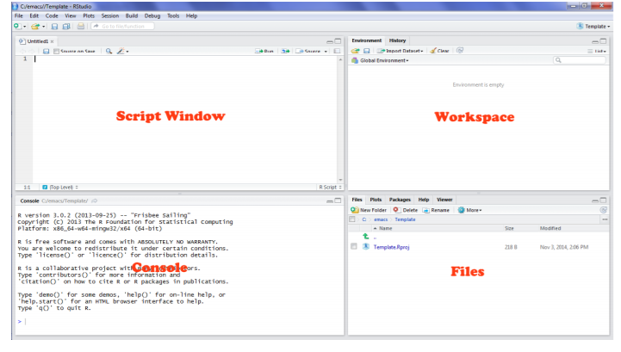
RStudio Interface

Slide 41
RStudio Interface
Script Window:
Where we open scripts with R commands
Can be organised into chunks
We can run the commands line by line/chunk by chunk/a full file
Console Window:
Where commands get executed and results shown
We can enter commands directly into the Console

Slide 42
RStudio Interface
Workspace/History Window:
Environment/Workspace tab
Contains a list of all the objects and variables contained in the current R environment.
Will contain all of the data files and analytic outputs from your analysis.
Can save and restore this
History tab
Contains a list of every command that has been executed in the Console.
Very handy backup – you can locate commands in history and sent to the Console.
Files Window:
Contains five tabs:
1) Files - The file directory structure of your current working directory,
2) Plots - Where any plots you generate are displayed,
3) Packages - Any packages you have loaded.
4) Help - Where you can find the help pages for every function installed in your version of R
5) Viewer - Used for displaying locally generated .html content.

Slide 43
Set Working Directory
This is the default location where you scripts etc. will be saved and R Studio will look for datasets
For the moment it is easier if you put your data set here
To find out what it is currently set to/change it
In R Studio Tools -> Global Options
In the General Tab you will see the location and be able to set it.

Slide 44
Getting Stated Loading the Dataset
Download data file needed
Go to: https://tinyurl.com/lawless2018
Click on the link PSI2018 on the top right
Click on Week 1 and Download salary.rds
Put it in your default working directory

Slide 45
Getting Stated Loading the Dataset
This is a small, simple dataset which contains the following variables:
Variables in the dataset
Name | Label | Values | Type
salary | Annual Salary |  | Scale
gender | Gender | 1=Female, 2=Male | Nominal
rank | Rank | 1=Assistant Professor, 2=Associate Professor, 3=Full | Nominal
exper | Years of experience |  | Scale
expcat | Years in current rank |  | Scale
dg | Highest degree obtained |  | Nominal

Slide 46
Note
This tutorial is based on using the script window but you can type these commands directly into the Console
They will appear in the History Window
At the end of the tutorial you can open a script and hit the To Source button on the history window to copy your commands across (select them all/chunk by chunk)

Slide 47
Getting Stated Loading the Dataset
In the Script Window
File -> New -> R Script
In the space file that appears untitled type in :
salary<-readRDS("salary.rds")
In the Script window click Run (top left of the screen)
The commands will be echoed on the Console
In your file type in
names(salary)
In the Script window click Run (top left of the screen)
The commands will be echoed on the Console and you will see some output.
Save the file File -> Save As (Save to a location that makes sense)

Slide 48
Descriptive Statistics
#You can look at the data in a variable by entering its name at the command prompt
salary$gender
#Or get a short overview using the str function
str(salary$gender)
#Or get a relevant statistical summary for a variable e.g. gender
summary(salary$gender)
#Or for salary
summary (salary$salary)
#Or get a summary of all the variables in the dataset“
summary(salary)

Slide 49
Frequency Tables
Can be used to illustrate frequency distribution of a categorical variable
Tells us what values the variable takes and how often it takes these values :
Gender | M | F
Frequency | 14 | 38
Rank | Assistant | Associate | Full
Frequency | 18 | 14 | 20

Slide 50
In R
We need to use a package
We are going to use pylr
You need to install it (just once)
install.packages(‘pylr’)
Then load it
library(‘pylr’)
Then create the table
count(salary$gender)

Slide 51
Contingency Table/Cross Tabulation
Matrix used to summarise the relationship between two categorical variables
Suppose we want to know the relationship between rank and gender – What is the probability that each gender will hold each rank
We create a table and then show the distributions
tab<-table(salary$gender, salary$rank)
addmargins(tab)
tab #just display the table with frequencies
prop.table(tab) # shows probability distribution
Note: we can make these look better using some additional packages – we will look at those later

Slide 52
Measure of Central Tendency
A descriptive statistic
A single number to serve as a representative value around which all the numbers in the set tend to cluster.
Need to choose the right measure for your data!

Slide 53
The Mode
The mode is the score that occurs most frequently in a set of data
The value with the greatest frequency on the distribution.

Slide 54
Bimodal Distributions
When a distribution has two “modes,” it is called bimodal

Slide 55
Multimodal Distributions
If a distribution has more than 2 “modes,” it is called multimodal

Slide 56
When To Use the Mode
The mode is not a very useful measure of central tendency
It is insensitive to large changes in the data set
That is, two data sets that are very different from each other can have the same mode

Slide 57
When To Use the Mode
The mode is primarily used with nominal variables
It is the only measure of central tendency that is appropriate for nominally scaled data
Example:
3, 7, 5, 13, 20, 23, 39, 23, 40, 23, 14, 12, 56, 23, 29
In order these numbers are:
3, 5, 7, 12, 13, 14, 20, 23, 23, 23, 23, 29, 39, 40, 56
In this case the mode is 23.

Slide 58
Back to Salary in RStudio
R doesn't have a built in function to compute the mode but there is a simple function which you can write and include in your code that will do it for you")
getmode <- function(v)
{
uniqv <- unique(v)
uniqv[which.max(tabulate(match(v,uniqv)))]
}
Using the function to get the mode of salary:
getmode(salary$salary)

Slide 59
The Median
Just another name for the 50th percentile
It is the score in the middle; half of the scores are larger than the median and half of the scores are smaller than the median
The middle score of a sequence of all the scores in a distribution arranged from lowest to highest.
Sort the data from highest to lowest
Find the score in the middle
middle = (N + 1) / 2
If N, the number of scores, is even the median is the average of the middle two scores

Slide 60
Median Example
What is the median of the following scores: 10 8 14 15 7 3 3 8 12 10 9
Sort the scores: 15 14 12 10 10 9 8 8 7 3 3
Determine the middle score: middle = (N + 1) / 2 = (11 + 1) / 2 = 6
Middle score = median = 9

Slide 61
Median Example
What is the median of the following scores: 24 18 19 42 16 12
Sort the scores: 42 24 19 18 16 12
Determine the middle score: middle = (N + 1) / 2 = (6 + 1) / 2 = 3.5
Median = average of 3rd and 4th scores: (19 + 18) / 2 = 18.5

Slide 62
The Mean
The arithmetic average of a group of scores; the sum of the scores divided by the number of scores.

Slide 63
Calculating the Mean
Calculate the mean of the following data: 1 5 4 3 2
Sum the scores (ΣX): 1 + 5 + 4 + 3 + 2 = 15
Divide the sum (ΣX = 15) by the number of scores (N = 5): 15 / 5 = 3
Mean = X = 3
The mean is sensitive to extreme values

Slide 64
Mean, Mode, Median
Does it make a difference?
UK Salary
Mean annual earnings £24,000 - £463 per week
Median earnings £377 per week
Mode earnings £270 per week (approx)

Slide 65
Measures of Central Tendency
Need to be considered in relation to the variability within the dataset.

Slide 66
Measures of Dispersion
Which of the distributions of scores has the larger dispersion?
The upper distribution has more dispersion because the scores are more spread out
That is, they are less similar to each other

Slide 67
Measures of Dispersion
Descriptive statistics that describe how similar a set of scores are to each other (or the range of scores)
The more similar the scores are to each other, the lower the measure of dispersion will be
The less similar the scores are to each other, the higher the measure of dispersion will be
In general, the more spread out a distribution is, the larger the measure of dispersion will be

Slide 68
Measures of Dispersion
There are three main measures of dispersion:
The range
The semi-interquartile range (SIR)
Variance / standard deviation

Slide 69
The Range
The range is defined as the difference between the largest score in the set of data and the smallest score in the set of data
Depends only on extreme values and provides no information about how the remaining data is distributed.
What is the range of the following data: 4 8 1 6 6 2 9 3 6 9
The largest score (XL) is 9; the smallest score (XS) is 1; the range is XL - XS = 9 - 1 = 8

Slide 70
When To Use the Range
The range is used when mainly for ordinal data
The range is rarely used in scientific work as it is fairly insensitive
It depends on only two scores in the set of data, XL and XS
Two very different sets of data can have the same range:

Slide 71
What is Variance?
Concerned with deviations from the mean (X-µ)
Actually the average of the squared differences from the mean
First subtract the mean from each of the scores
This difference is called a deviate or a deviation score
The deviate tells us how far a given score is from the typical, or average, score
Thus, the deviate is a measure of dispersion for a given score
Then square the result
Why?
If we just added up the differences from the mean the negatives would cancel the positives
If we used absolute values we wouldn’t get an accurate measure of spread
Squaring is the best option

Slide 72
Variance
Concerned with deviations from the mean (X-µ)
Variance is defined as the average of the deviations from the mean squared:
N here is the degrees of freedom = the number of independent pieces of information on which the estimate is based

Slide 73
Standard Deviation
Concept was first introduced by Karl Pearson in 1893.
The standard deviation is the most useful and the most popular measure of dispersion.
Use Greek symbol sigma σ
We calculate the variance
The square root of this sum is knows as standard deviation.
Standard deviation = the square root of the Variance

Slide 74
Standard Deviation
The larger the value the more spread out around the mean the data is, smaller means less spread.
The Empirical Rule:
The 68-95-99.7 Rule
In the normal distribution with mean µ and standard deviation σ:
68% of the observations fall within σ of the mean µ.
95% of the observations fall within 2σ of the mean µ.
99.7% of the observations fall within 3σ of the mean µ.
Allows us to see how spread out individual cases are from the mean

Slide 75
Standard Deviation
This is helpful in comparing samples.
For Example
Cork IT and DIT have the same mean test score for Probability and Statistics than DIT with the same number of students in each data set
Does this mean that students performed equally well?
Suppose there are the same number of students in each dataset
If the mean for DIT is 60 and the standard deviation is 1.6 then
68% of the values in the dataset will lie between 58.4 and 61.6
MEAN-1SD (60-1.6=58.4) and MEAN+1SD (60+1.6=61.6)
99% of the values will lie between 55.2 and 64.8
MEAN-3SD (60-4.8=55.2) and MEAN+3SD (60+4.8=64.8)
If the mean for CIT is 60 and the standard deviation is 4.3
68% of the values in the dataset will lie between 55.7 and 64.3
MEAN-1SD (60-4.3=55.7) and MEAN+1SD (60+4.3=64.3)
99% of the values will lie between 47.1 and 72.9
MEAN-3SD (60-12.9=47.1) and MEAN+3SD (60+12.9=72.9)

Slide 76
The Interquartile Range
The Interquartile range (IQR) is defined as the difference of the first and third quartiles divided by two
The first quartile is the 25th percentile
The third quartile is the 75th percentile
IQR = (Q3 - Q1) / 2

Slide 77
Example
What is the IQR for the data to the right?
25 % of the scores are below 5
5 is the first quartile
25 % of the scores are above 25
25 is the third quartile
IQR= (Q₃ - Q₁) / 2 = (25 - 5) / 2 = 10

Slide 78
Which measures should we use?
It depends on
The expectations of your area
On the size of your sample
On the distribution of your data
Need always to look at this and then make a decision whether A and B allow you to consider your data to fit the normal distribution.

Slide 79
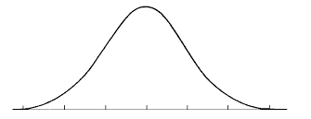
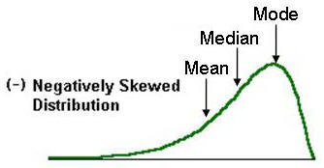
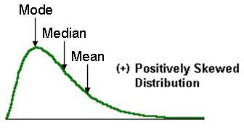
Measure of Skew
Skew is a measure of symmetry in the distribution of scores
If the curve has one tail that is longer than the other, it is skewed.
If the longer tail is on the left, it is negatively skewed (too many scores toward the negative end).
If the longer tail is on the right, it is positively skewed
Normal (skew = 0)

Slide 80
Relations Between the Measures of Central Tendency
In symmetrical distributions, the median and mean are equal
For normal distributions, mean = median = mode
In positively skewed distributions, the mean is greater than the median
In negatively skewed distributions, the mean is smaller than the median

Slide 81
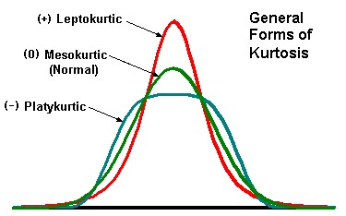
Kurtosis
Kurtosis measures whether the scores are spread out more or less than they would be in a normal (Gaussian) distribution
When the distribution is normally distributed, its kurtosis equals 3 and it is said to be mesokurtic
When the distribution is less spread out than normal, its kurtosis is greater than 3 and it is said to be leptokurtic
When the distribution is more spread out than normal, its kurtosis is less than 3 and it is said to be platykurtic

Slide 82
When To Use the Median & IQR
The median is often used when the distribution of scores is either positively or negatively skewed
The few really large scores (positively skewed) or really small scores (negatively skewed) will not overly influence the median
The IQR is often used with skewed data as it is insensitive to the extreme scores

Slide 83
When To Use the Mean and Standard Deviation
You should use the mean when
the data are interval or ratio scaled
Many people will use the mean with ordinally scaled data too
and the data are not skewed
The mean is preferred because it is sensitive to every score
If you change one score in the data set, the mean will change
If you use mean you also use standard deviation

Slide 84
Back to Salary in RStudio
Measures of Central Tendency
mean(salary$salary)
You can assign the outcome to a variable
meansal <- mean(salary$salary)
and then display it on screen
meansal
Or use the print function to make it look the way you want
print(meansal, digits=1)
#Median
median(salary$salary)

Slide 85
Measures of Dispersion
#Range
range(salary$salary)
#Quantiles
quantile(salary$salary)
#to get 1st quantil
x=quantile(salary$salary); x[1]
#Interquartile Range
IQR(salary$salary)
#Variance
var(salary$salary)
#Standard deviation
sd(salary$salary)
#Rounded
round(sd(salary$salary,2)) #rounded to 2 decimal places

Slide 86
Some Key Concepts
Sample
(Size, representativeness, extremes);
Differing types of variable
(nominal/categorical, ordinal, interval and ratio);
Measures of central tendency
(the mean, median and mode);
Measures of dispersion
(range, inter-quartile range, variance and standard deviation).
Shape
(normal, skew, kurtosis)

Slide 87
Last Thing for this week

Slide 88
RCommander
RCommander provides us with a GUI to some common statistical tasks
We are going to try to use it but it may not be possible (people with MACs may have difficulty)
You need to install the Rcmdr package in R

Slide 89
R Studio
Install R Commander
install.packages('Rcmdr')
Note:
Sometimes you will get an error re other packages missing which are needed in order to get Rcmdr to work. If you do then install those packages.
Launch RCommander
library('Rcmdr')
The Rcommander window should launch

Slide 90
RCmdr on Mac
Make sure that your Mac OS X system is up-to-date by running Software Update from the "apple" menu at the top-left of the screen
Check to see whether the X11 windowing system (X Windows) has already been installed on your computer.
For OS X 10.6 and 10.7, the file X11.app should appear in the Utilities folder under Applications in the finder.
This application should always be installed under OS X 10.7.
For OS X 10.8 or higher, the file is named XQuartz.app and is no longer included with the operating system.
XQuartz.app may also be installed in OS X 10.6 or 10.7.
(The R Commander uses the tcltk package for R, which requires X-Windows.) Note that if and when you upgrade OS X, you will have to reinstall XQuartz even if you installed it previously.
If neither X11.app nor XQuartz.app is installed, install XQuartz.
In fact, regardless of whether some version of X-Windows is installed on your computer, it shouldn't hurt to install the current version of XQuartz.
Download the disk image (dmg) file for XQuartz.
When you open this file by double-clicking on it, you'll find XQuartz.pkg; double-click on it to run the installer, clicking through all the defaults.
After the installer runs, you'll have to log out and back on to your Mac OS X account, or just reboot your computer.
Source: https://socialsciences.mcmaster.ca/jfox/Misc/Rcmdr/installation-notes.html

Slide 91
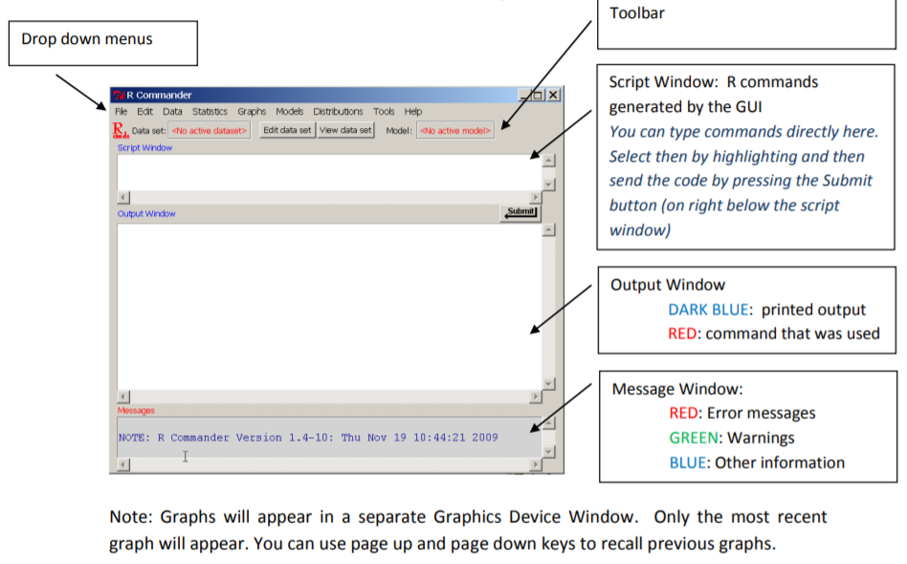
R Commander

Slide 92
Detailed help on RCommander
https://cran.r-project.org/doc/contrib/Karp-Rcommander-intro.pdf

Slide 93
Trying out RCommander
To launch (once installed)
library('Rcmdr')
Hit No Active Dataset and a list will of all datasets in your working directory (or available via the package) will be displayed
Select one to load (Note how the R commands are echoed in the R Script window and you can save/copy these for later use)
Once loaded then you can view the dataset (hit the View Dataset button)
Under the Statistics menu you can access a lot of different options
Explore what is available under summaries
Note: If no datasets are shown,
Download regression.xls (This has students exam results for reading age 7 on the Standard London Reading Test(standlrt) plus their grade for english at GCSE(normexam))
Choose Data-> Import Data ->From Excel
Then hit View Dataset button and proceed with summaries

